Slide 1

Decimal Point Analytics (DPA) Hackathon 2026 - Vivechana
Decimal Point Analytics
Stage 2 Case Study 2
Public Transport Feedback & Service Analytics Platform
By
Veritas AI Team
Madki Sai Charan, Poshala Prabhanajali, Margala Vaishnavi.
Institute of Aeronautical Engineering, Dundigal.

Slide 2
Problem Statement
PASSENGER SIGNALS
OPERATIONAL
GAP
OBJECTIVE
Route, trip and journey date/time
Punctuality & delays
Vehicle cleanliness
Passenger crowding
Driver behaviour
Overall journey experience
Free-text comment
Raw records
Feedback arrives as individual observations.
Build one working pipeline that connects
Hidden patterns
Route and time relationships are difficult to see manually.
feedback → classification → storage → analytics → operational insight
Late detection
Deterioration may only become visible after complaints accumulate.
Decision support
Operations teams need a single evidence-based view.
DATA-DRIVEN
The challenge is not collecting a complaint; it is identifying recurring patterns across routes, categories, severity and time periods.
Veritas AI | DPA Hackathon 2026 | IARE
Notes:
Explain that public transport feedback is multi-dimensional. A record has structured service ratings, route and time context, and an unstructured comment.
The technical problem is converting these individual records into route-level evidence. The platform therefore treats feedback as the source data for classification, aggregation, ranking and deterioration analysis.
The objective is an integrated working pipeline rather than a collection of disconnected screens.

Slide 3
Solution Workflow
KEY PRINCIPLE
1
2
3
4
5
6
Passenger
Classify
Persist
Analyze
Detect
Act
Dashboard values are computed from underlying feedback records.
Submit route, trip,
ratings and comment
Category
+
Severity
+
Confidence
FastAPI validation
+ SQLAlchemy
Pandas
+
NumPy
aggregations
Route ranking +
Deterioration
Admin dashboard
+
Insights
Not hard-coded UI content.
• 10 routes • 50+ trips • 200+ feedback records • approximately 60 days of data
Veritas AI | DPA Hackathon 2026 | IARE
Notes:
Walk through the pipeline left to right.
The passenger creates a structured feedback record. The comment can be classified into operational categories and severity. The FastAPI backend validates and persists the record. Pandas and NumPy then aggregate the stored records.
The route-ranking and deterioration logic operate on those aggregates, and the resulting findings are displayed in the administrator dashboard.
The important technical point is that the dashboard is downstream of the data; it is not a static illustration.

Slide 4
Real System Architecture
• Passenger / Operations Admin
RUNTIME DATA PATH
USERS
Feedback request
FRONTEND
• React + TypeScript + Vite
• Tailwind CSS • React Router
• Recharts • Lucide React
FastAPI endpoint
Validated model
• FastAPI + Uvicorn • Pydantic validation
• REST API • JWT authentication
API
Database record
PERSISTENCE
• SQLAlchemy ORM
• SQLite for local development
• PostgreSQL-compatible architecture
Analytics result
Dashboard view
ANALYTICS
/ AI
• Pandas + NumPy
• Modular local rule-based NLP classifier
Veritas AI | DPA Hackathon 2026 | IARE
Notes:
The architecture separates presentation, API, persistence and intelligence.
React and TypeScript form the client. FastAPI provides REST endpoints and Uvicorn runs the service. Pydantic handles input validation and JWT is used for authenticated admin access.
SQLAlchemy is the persistence layer. SQLite is used for local development, while the architecture is PostgreSQL-compatible for deployment.
Pandas and NumPy operate on the data, while the classifier is modular so the local rule-based NLP implementation can later be replaced or complemented by a local LLM.

Slide 5
Technology Stack & Backend Design
FRONTEND
BACKEND
ANALYTICS / AI
React
TypeScript
Vite
Tailwind CSS
React Router
Recharts
Lucide React
Python
FastAPI
Uvicorn
Pydantic
React Router
SQL Alchemy
JWT authentication
Pandas
NumPy
Rule-based NLP
Local LLM integration path
FEEDBACK RECORD
route
trip
journey date/time
crowding
driver behaviour
overall rating
comment
trip
punctuality
cleanliness
One stored record can feed classification, complaint counts, route ratings, time analysis and deterioration detection.
Veritas AI | DPA Hackathon 2026 | IARE
Notes:
The technology stack is deliberately conventional and production-oriented.
The frontend uses React, TypeScript and Vite, with Tailwind CSS for styling, React Router for navigation, Recharts for analytics visuals and Lucide React for icons.
The backend is Python with FastAPI, Uvicorn, Pydantic and SQLAlchemy, with JWT authentication for the admin path.
The feedback record is the common data contract. It contains the operational context and service ratings needed by the analytics engine, plus the comment used by the AI classifier.

Slide 6
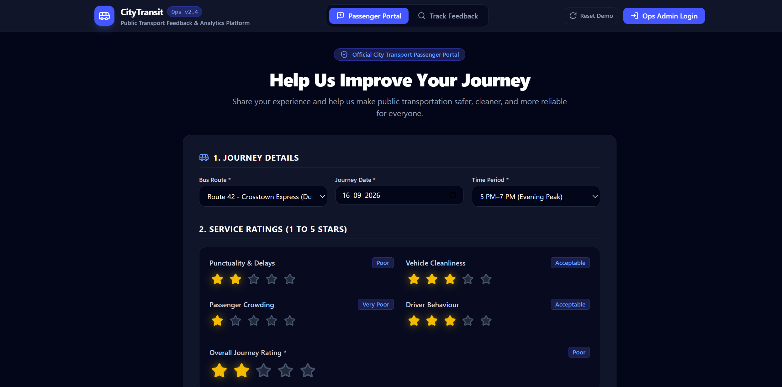
Passenger Feedback Experience
The form creates the data record that enters the backend workflow.
ACTUAL PRODUCT UI
Bus route
Journey date
Time period
Four service ratings
Overall journey rating
Passenger comment
Fig 1. Actual deployed UI — structured feedback capture
Veritas AI | DPA Hackathon 2026 | IARE
Notes:
This is the actual deployed Passenger Portal screenshot supplied for the project.
The portal captures route, journey date, time period, four service ratings, overall journey rating and a free-text comment.
This structured design is important for analytics because route and time context are collected explicitly rather than being inferred from the comment. The resulting submission becomes the input to the backend and persistence workflow.

Slide 7
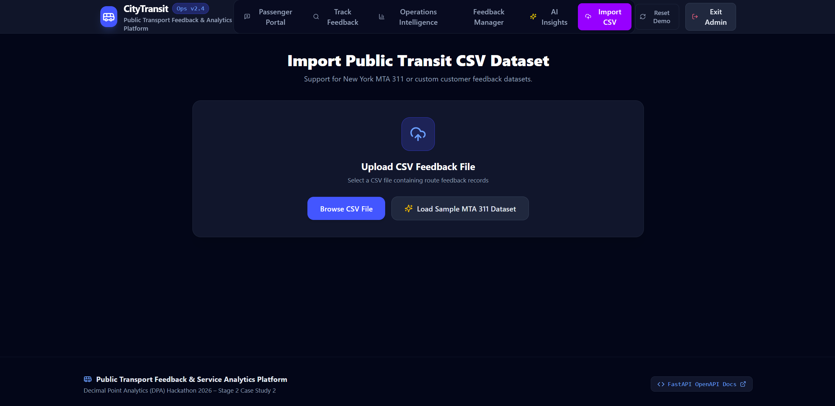
Data Ingestion & Persistence
Actual deployed screen supports New York MTA 311 or custom customer feedback datasets.
LIVE FEEDBACK
1. Submit
Passenger portal sends structured request
2. Validate
FastAPI + Pydantic validate the payload
3. Store
SQLAlchemy writes the feedback record
Persistence target
SQLite locally → PostgreSQL-compatible deployment architecture
Fig 2. CSV Import
Veritas AI | DPA Hackathon 2026 | IARE
Notes:
The system has a second ingestion path for datasets.
The left side summarizes the live passenger flow: submission, Pydantic validation and SQLAlchemy persistence.
The right side is the actual deployed CSV Import screen. It explicitly supports New York MTA 311 or custom customer feedback datasets.
This makes the analytics engine useful not only for newly submitted feedback but also for imported datasets, without inventing a separate UI workflow.

Slide 8
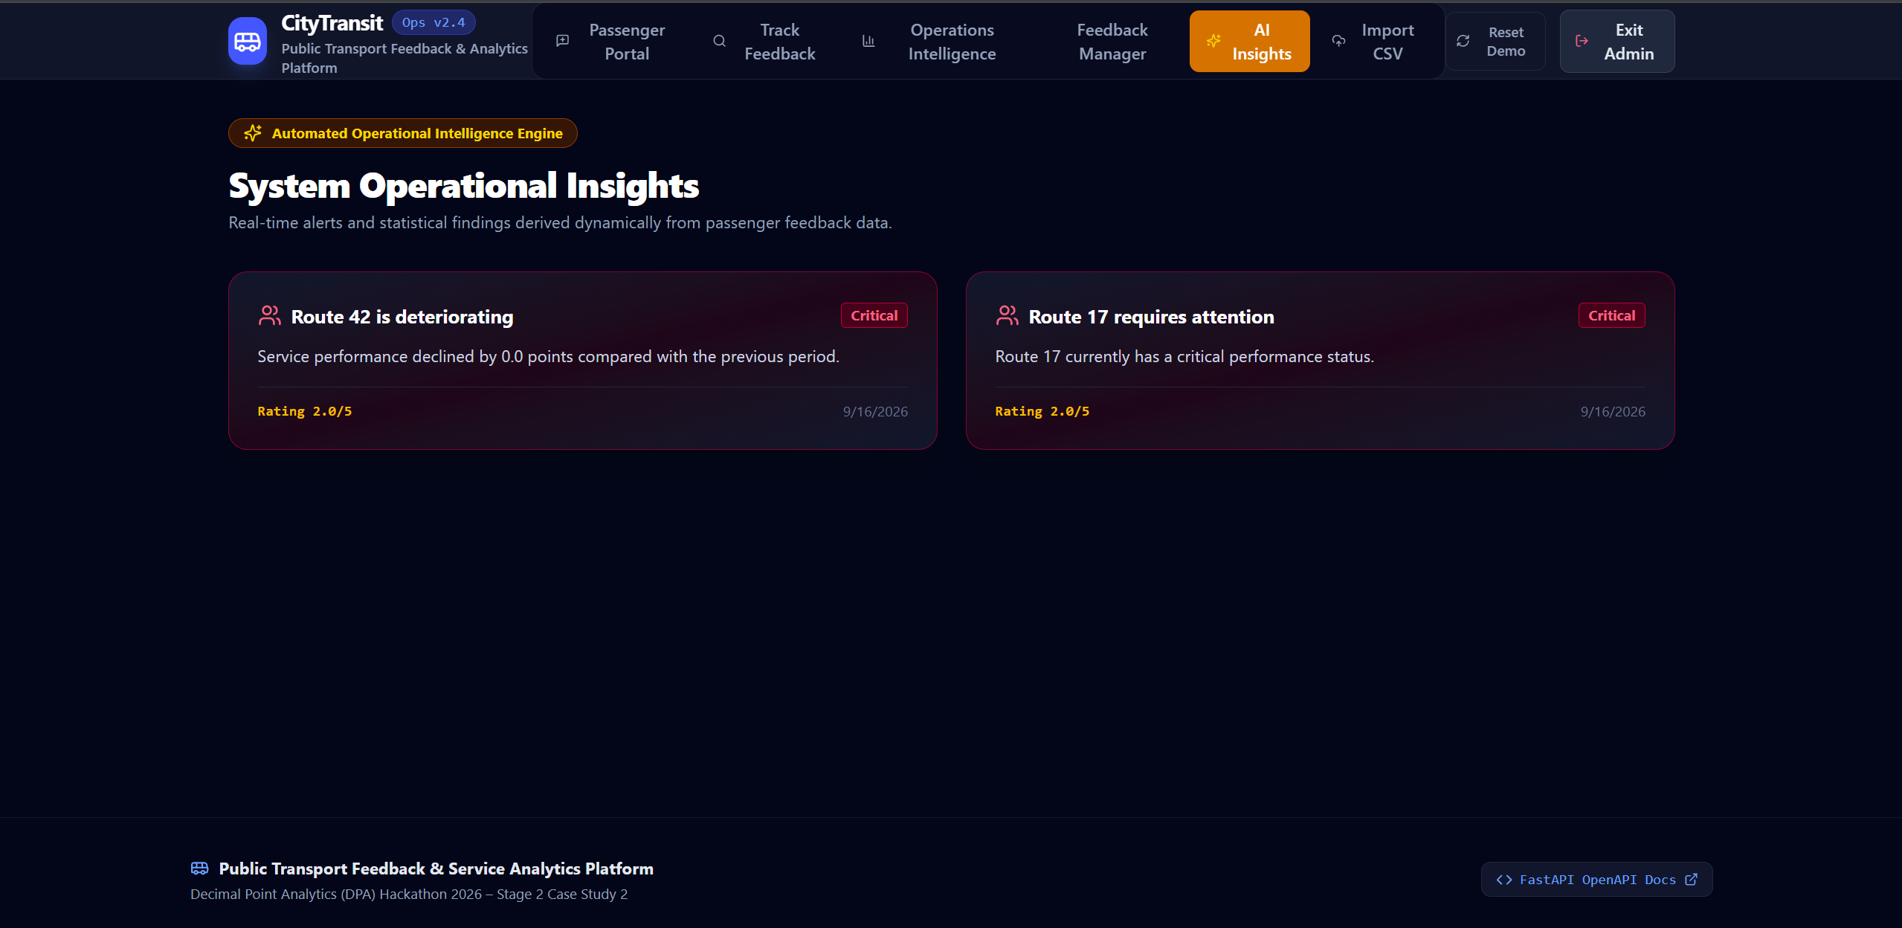
AI Feedback Classification
The supplied screenshot is used as the UI source of truth; the classification example above is shown as the technical transformation.
Modular NLP layer: comment → category → severity → confidence
INPUT
“The bus is always packed after 6 PM and often arrives late.”
Crowding
Punctuality
Severity: High
Confidence: 0.94
Current implementation:
Local rule-based NLP classifier.
Designed for a local LLM integration later.
Fig 3. AI Insights
Veritas AI | DPA Hackathon 2026 | IARE
Notes:
This slide separates the classification logic from the product screenshot.
The specified example comment contains two operational signals: the bus is packed, indicating crowding, and it arrives late, indicating punctuality. The intended output is Crowd­ing + Punctuality, High severity and 0.94 confidence.
The current classifier is modular and local, based on rules for the present implementation. The architecture leaves a clean path for a local LLM to be introduced later.
The screenshot on the right is the supplied actual deployed AI Insights page. I am using it only for the real product UI; I am not fabricating a separate classification screenshot.

Slide 9
Python Analytics Engine
Pandas + NumPy convert feedback records into comparable operational signals.
Deterioration compares current and previous periods using rating decrease, complaint increase and high/critical complaint increase.
INPUT
FILTER
AGGREGATE
RANK
COMPARE
Date
route
Category
severity
time slot
Counts
Means
issue frequencies
Ratings + complaints
+ severity
Current vs previous
period
ROUTE RANKING SIGNALS
TIME BUCKETS
Overall rating
Cleanliness
Driver behaviour
Severity
Punctuality
Crowding
Complaint volume
6–9 AM
9 AM–12 PM
12–3 PM
3–5 PM
5–7 PM
7–10 PM
Veritas AI | DPA Hackathon 2026 | IARE
Notes:
The analytics engine is based on Pandas and NumPy.
The processing sequence is filter, aggregate, rank and compare. Filters can narrow the population by route, date, category, severity and time slot. Aggregations calculate counts, means and issue frequencies.
Route ranking considers overall rating, the individual service dimensions, complaint volume and severity.
Time analysis uses the six defined buckets. Deterioration detection compares the current period with the previous period using rating decrease, complaint increase and high or critical complaint increase.

Slide 10
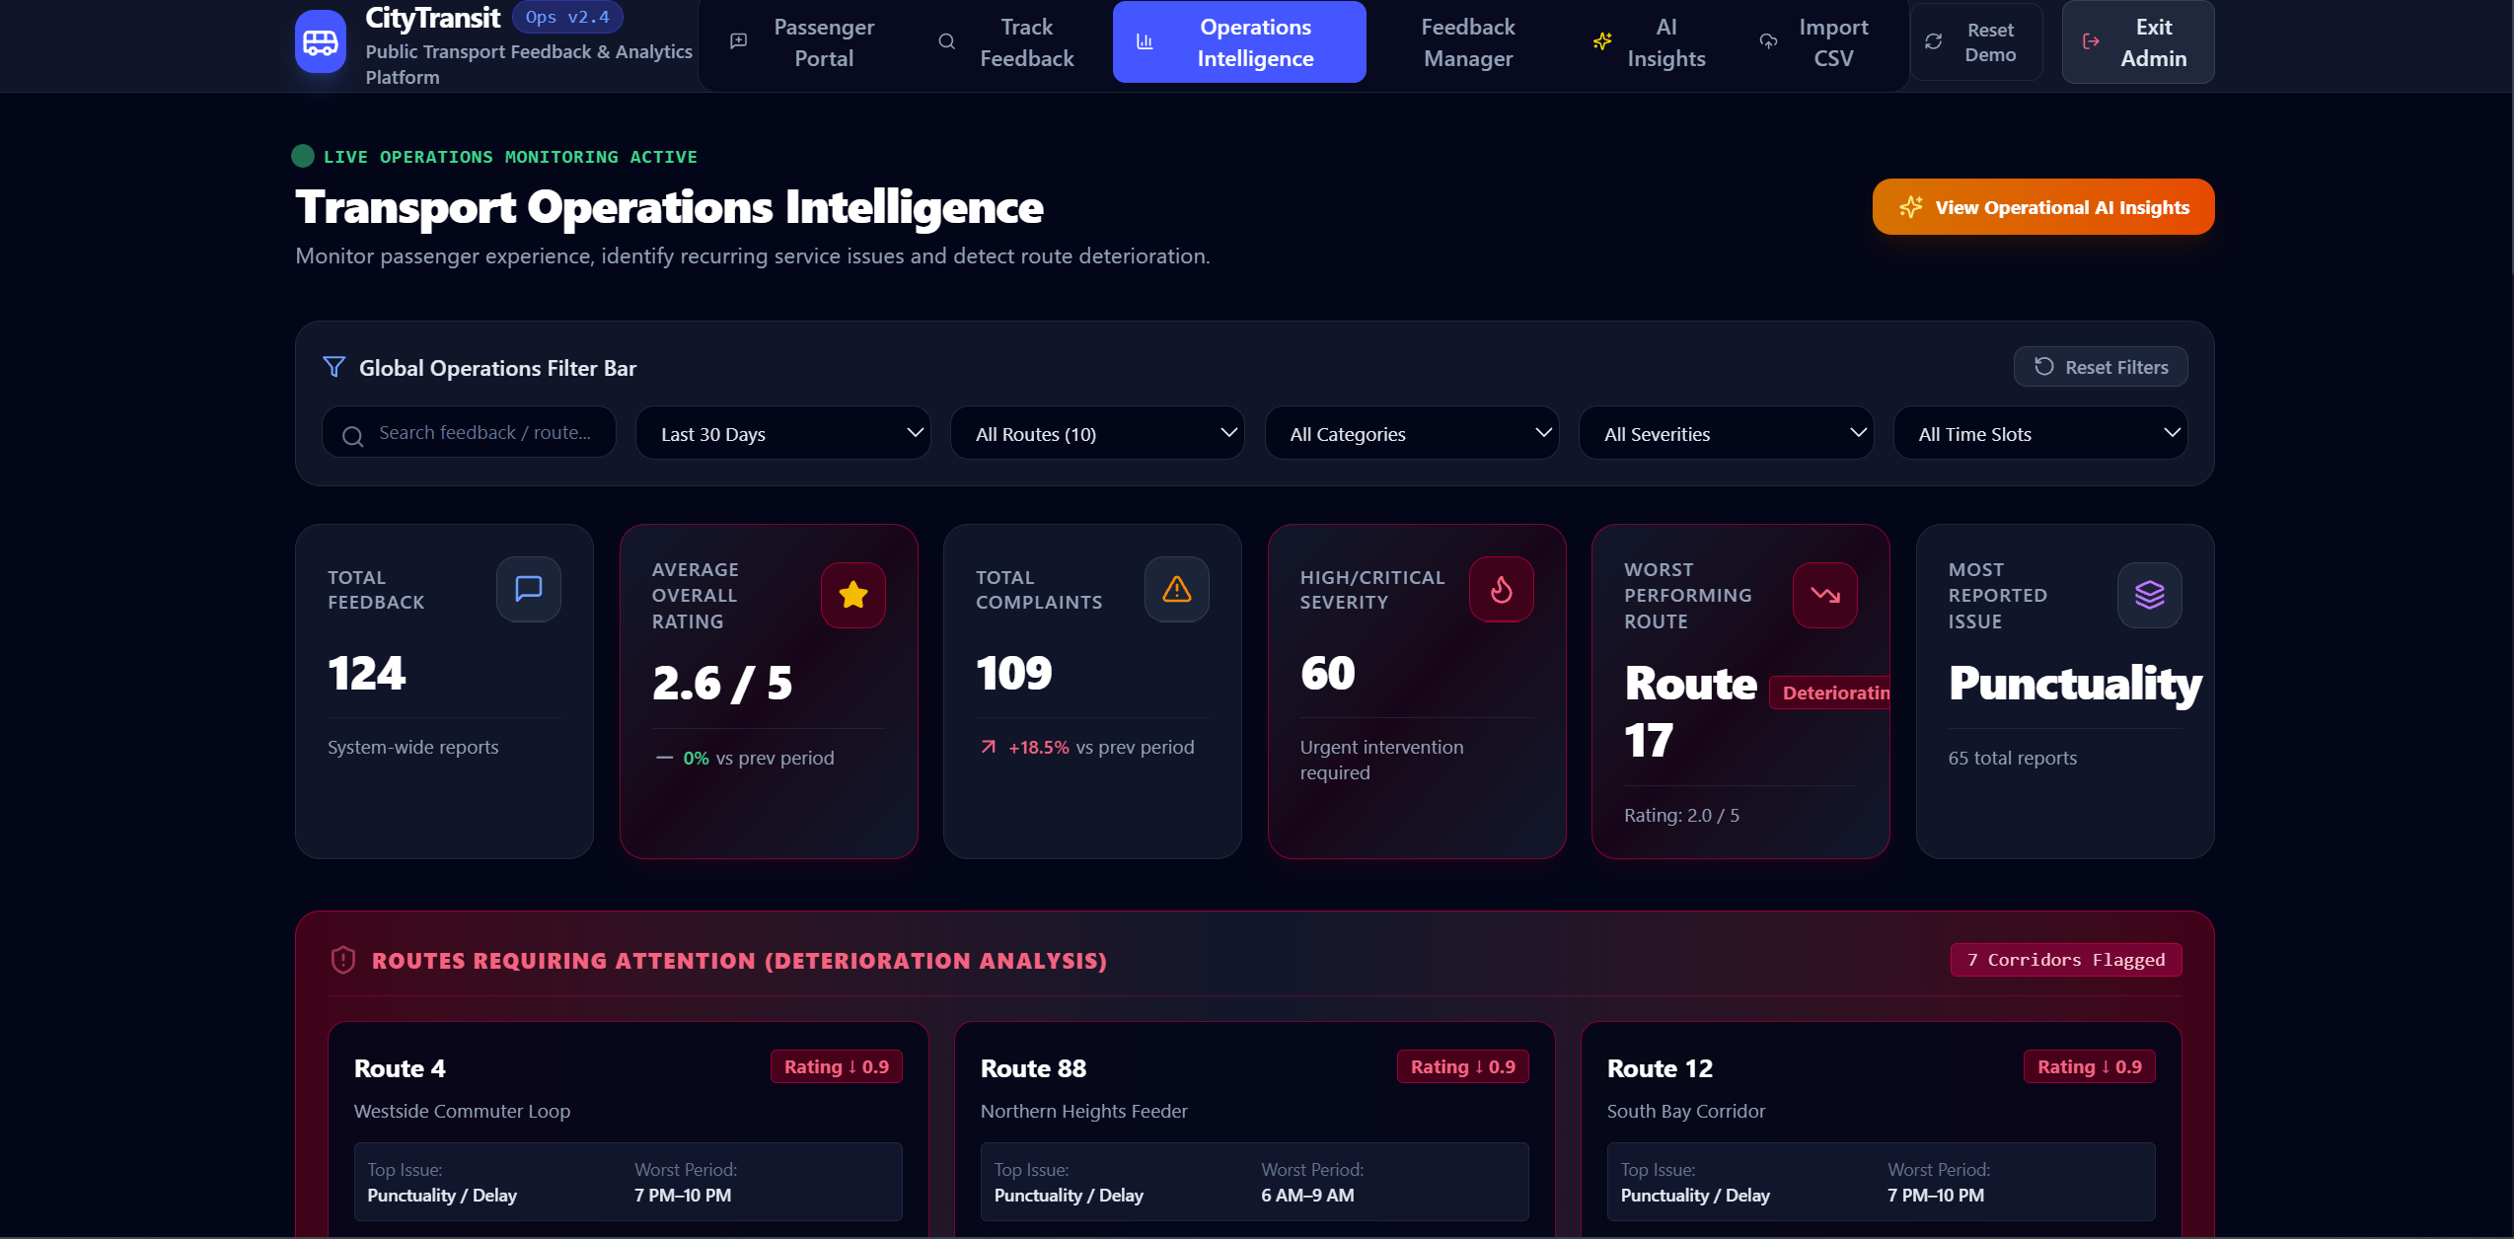
Operations Intelligence Dashboard
This view consumes analytics derived from feedback records; it is not a hard-coded dashboard.
Fig 4. Transport Operations Intelligence Dashboard
Veritas AI | DPA Hackathon 2026 | IARE
Notes:
This is the actual deployed Transport Operations Intelligence screen supplied for the project.
The screenshot demonstrates the operations-facing experience: global filters, total feedback, average overall rating, complaint volume, high or critical severity, worst-performing route, most-reported issue and deterioration analysis.
The key technical claim is not the appearance of the cards. It is the data flow behind them: the dashboard consumes computed analytics from the feedback records.

Slide 11
Route 42 Case Study
Deterioration detection demonstrated through a deliberately stressed seed route.
Note: The supplied deployed AI Insights screenshot currently renders Route 42 at 2.0/5; displayed values can change with the underlying dataset.
ROUTE 42
DYNAMIC FINDINGS EXPECTED FROM THE SEED DATA
DETERIORATING
PRIMARY ISSUE
SECONDARY ISSUE
Crowding
Punctuality / Delays
Project case specification
WORST PERIOD
COMPLAINT PATTERN
≈ 2.7 / 5 overall rating
5 PM–7 PM
High volume
Primary issue: Crowding
Secondary: Punctuality / Delays
Worst period: 5 PM–7 PM
RECENT TREND
STATUS
Increasing complaints
Deteriorating
Deterioration signal: rating ↓ + complaints ↑ + high/critical complaints ↑
Veritas AI | DPA Hackathon 2026 | IARE
Notes:
Route 42 is the central case study because the seed dataset deliberately represents it as deteriorating.
The project specification describes the expected Route 42 pattern as approximately 2.7 out of 5 overall, crowding as the primary issue, punctuality and delays as the secondary issue, 5 PM to 7 PM as the worst period, high complaint volume, increasing recent complaints and a deteriorating status.
There is an important source-of-truth distinction: the supplied deployed AI Insights screenshot currently displays Route 42 at 2.0 out of 5 and a 0.0-point change. I have therefore not altered the screenshot or pretended those values are identical. The dashboard values are dynamic and can change with the underlying dataset.

Slide 12
Deterioration Detection & Operational Interpretation
CURRENT PERIOD
THREE SIGNALS
OUTPUT
Aggregate feedback
for the selected window
Δ
Route requires
attention
Rating decrease
Complaint increase
Δ
COMPARE
The finding is surfaced in the admin intelligence view for further operational review.
Current vs previous period
High / critical increase
Δ
Time context
6–9 AM
9 AM–12 PM
12–3 PM
3–5 PM
5–7 PM
7–10 PM
Veritas AI | DPA Hackathon 2026 | IARE
Notes:
Deterioration is a comparison problem.
The engine aggregates the selected current period and compares it with the previous period. Three signals are used: a decrease in rating, an increase in complaint volume, and an increase in high or critical complaints.
When the combination indicates deterioration, the route is surfaced in the operational intelligence view.
The time buckets provide context so an operations team can see whether the issue is concentrated in a particular part of the day.

Slide 13
Impact & Future Scope
WHAT IS DEMONSTRATED
FUTURE SCOPE
Unified feedback
Structured ratings + comments
1
Integrate a local LLM behind the classifier interface
Working backend
FastAPI + validation + persistence
2
Move production persistence from SQLite to PostgreSQL
Dynamic analytics
Pandas / NumPy over stored records
3
Expand longitudinal trend analysis
Automated intelligence
NLP classification + deterioration detection
4
Extend operational workflows around detected issues
Reusable ingestion
Passenger submissions + CSV datasets
5
Support additional transit feedback sources
PASSENGER VOICE → STRUCTURED SIGNAL → OPERATIONAL DECISION SUPPORT
Veritas AI | DPA Hackathon 2026 | IARE
Notes:
Closing:
The system demonstrates a complete working feedback-intelligence loop.
The current implementation already connects the passenger portal, FastAPI backend, SQLAlchemy persistence, Python analytics, modular NLP classification, CSV ingestion and the operations dashboard.
The future scope is deliberately incremental: integrate a local LLM behind the existing classifier contract, move production persistence to PostgreSQL, expand longitudinal analysis and add more transit feedback sources.
The key takeaway for the judges is that passenger feedback is not merely displayed. It is converted into structured operational signals that can support route-level decision making.

Slide 14

Thank You

